Slide 1
TRAUMATIC INJURIES OF TEETH
Elli’s class IV - IX

Slide 2
Ellis and davey’s classification (1970)
Class I -Fracture involving enamel
Class II -Fracture involving enamel & dentin
Class III -Fracture involving enamel,dentin & pulp
Class IV -Teeth that lost their vitality with or without
loss of crown
Class V -Traumatically avulsed tooth
Class VI -Fracture of the root with or without crown fracture
Class VII -Displacement of the tooth without crown/root fracture
Class VIII -Cervical crown fracture
Class IX -Fracture of deciduous teeth

Slide 3
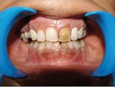
Ellis class iv
traumatized tooth become non vital
(with or with out loss of crown structure)
Discolored tooth

Slide 4
Treatment modalities for
Ellis class IV
Ellis IV
(non vital)
Open apex
Apexification
revascularization
Closed apex
Root canal treatment

Slide 5
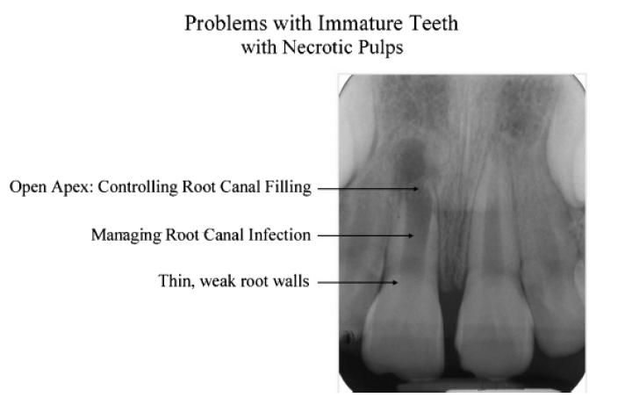
Immature teeth
A non vital immature teeth present a number of difficulties
for adequate endodontic therapy.
The canal wider apically than coronally
Lack of apical stop and
Susceptible to leakage.
Weak walls is more susceptible to fracture

Slide 6
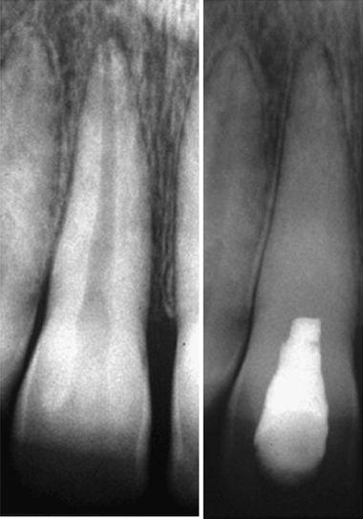
Apexification:
Apexification is defined as ‘a method to induce a calcified barrier in a root with an open apex or the continued apical development of an incomplete root in teeth with necrotic pulp
Traditionally : CaOH
MTA
CMCP
REVASCURALISATION

Slide 7
Objectives:
-remove necrotic pulpal tissue
-eliminate bacterial contamination
-induce root closure
-maintain a functional tooth
Indications:
1. Permanent tooth with incomplete root formation
2. History : Pain

Slide 8
3. Clinically:
-possible abscess/fistula
-no extreme mobility
-large carious lesion with necrotic pulpal tissue
4. Radiographic:
-pulpal exposure
-no internal or external root resorption

Slide 9
Favourable outcome:
- Root end closure (apexification) at the apices of immature roots or an apical barrier, as evidenced by radiographic evaluation.
- Adverse post-treatment clinical signs or symptoms of sensitivity, pain, or swelling should not be evident.
- There should be no radiographic evidence of external root resorption, lateral root pathosis, or breakdown of periradicular supporting tissues during or following therapy.

Slide 10
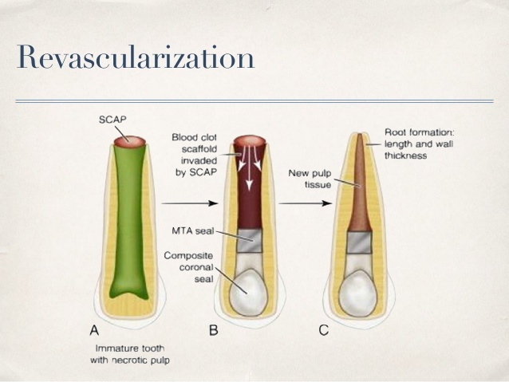
Pulp revascularization
Revascularization is a new treatment method for immature
necrotic permanent teeth
Pulp revascularization is dependent on the ability of residual pulp
and apical and periodontal stem cells to differentiate.
These cells have the ability to generate a highly vascularized and a
conjunctive rich living tissue.
This one is able to colonize the available pulp space.
Notes:
Andresan defined revascualrization as restoration of vascularity of tissue or organ.gpoals ofvregenerative endo are:elimination of symptoms and evidence of bony healing ,secondary goal : is to increased root wall thickness and root length.n 3 rd goal is to positive response to pulp vitality .

Slide 11
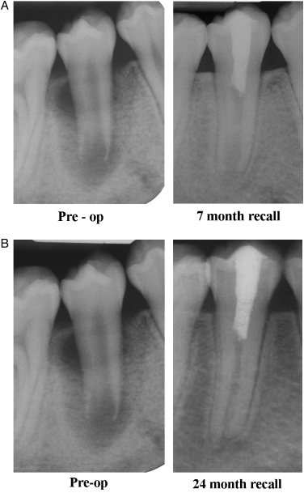
TECHNIQUE: The canal was disinfected without mechanical
instrumentation but with copious irrigation with 5.25% sodium
hypochlorite the use of a mixture of antibiotics for 4 weeks
A blood clot was produced to the level of the cementoenamel
junction
Seal of MTA in the cervical area and a bonded resin
coronal restoration above it.

Slide 12
Management of discoloration
Discolorations may be classified as
Extrinsic stains: Extrinsic stains are located on the outer surfaces of the teeth.
Intrinsic stains: Intrinsic stains are those which are internal or present with in the tooth structures
Etiology:
Vital teeth: During crown formation
Hereditary disorders
Medications (Tetracycline preparations)
Notes:
Mec of bleaching :free radicals react vth unsaturated bonds and large stained molecules are cionverted to smaller ones simpler molecules are formed and reflects less light or colourless

Slide 13
Excess fluoride injection
Exanthamatous fever
Trauma
Staining may be located in enamel / dentin. Discoloration restricted to dentin may still show through enamel.

Slide 14
Treatment for discoloration
Intra coronal bleaching:
Sodium perborate + hydrogen peroxide
For 1 week
Over bleaching for 1 or 2 shades
Composite veneering
Technique of non-vital bleaching:
  In office thermocatalytic technique.
  Out of the office technique (walking bleach).
  Combination of these two.

Slide 15
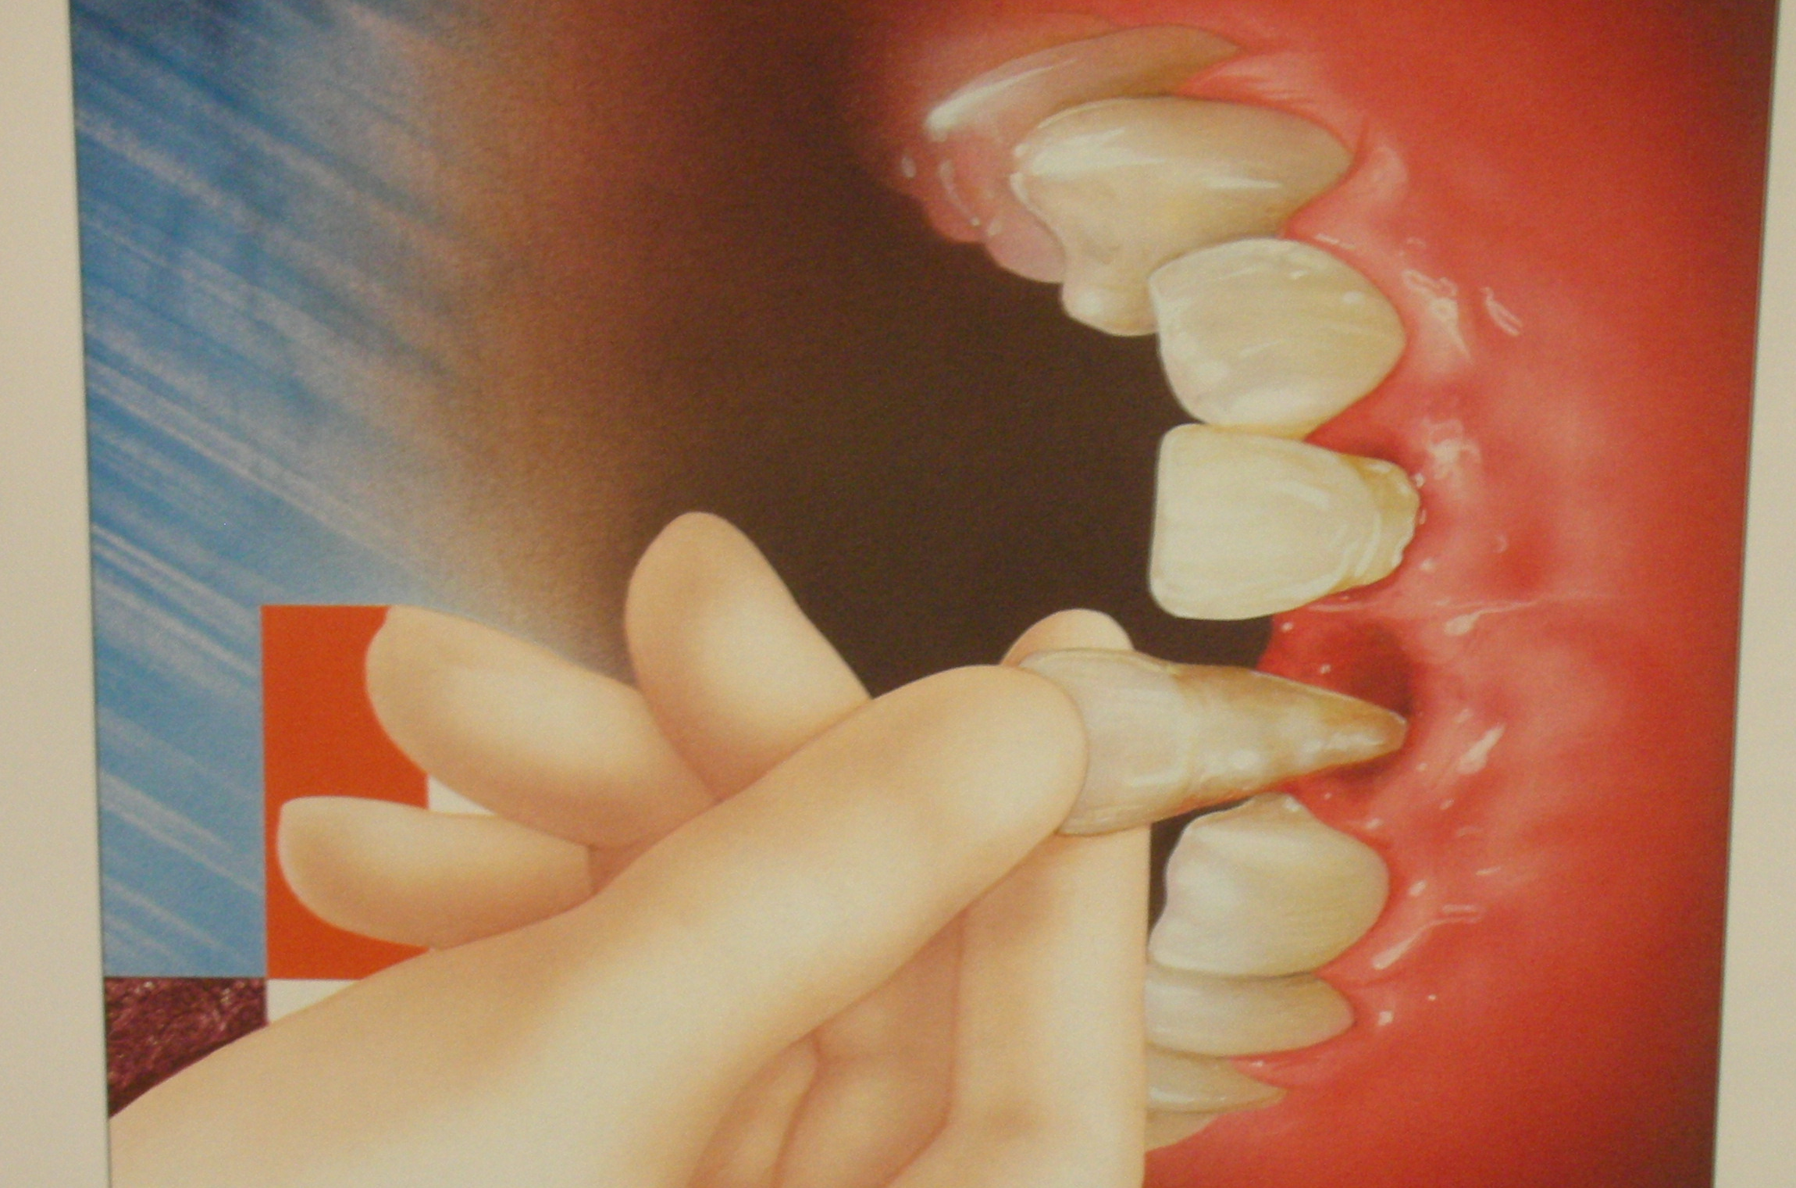
AVULSION

Slide 16
Avulsion:
Tooth avulsion (exarticulation) implies total displacement of the tooth out of the socket
(-Andreasen JO &Andreasen FM, 2001)
Complete displacement of the tooth from the alveolar socket
(International health organization).
An avulsion injury occurs because if an horizontal impact resulting in a complete displacement from the socket & the neurovascular supply is severely compromised resulting in loss of vascularization of the pulp.

Slide 17
The reported incidence of tooth avulsion ranges from 0.5 - 3% of all traumatic dental injuries of the permanent teeth.
7-13% in primary teeth.
Common age in permanent teeth 8-12 yrs.
Etiologic factors:-
Permanent dentition- fights and sports injuries
Primary dentition- falls against hard object

Slide 18
Clinical findings:
In both dentitions maxillary central incisors are the most frequently avulsed teeth.
Frequently single tooth but multiple avulsions are occasionally encountered .
Associated injuries like fractures of the socket wall & injuries to lips are common.
Radiographs taken to rule out associated alveolar fractures & intrusion in case of primary teeth.

Slide 19
Radiographic findings:
Four films ( maxillary anterior, 3 periapical from various angles ) to evaluate dental injury, displacement or possible complete intrusion
A panorex may be used to evaluate foreign bodies , displacement and maxillary and mandibular fractures.

Slide 20
Healing and PATHOLOGY
PULPAL
Regular tubular reparative dentin
Irregular reparative dentin
Osteodentin
Irregular immature bone
Regular lamellated bone / cementum
Internal resorption
Necrosis

Slide 21
Signs of healing can be seen within 2wks after replantation, where in damaged coronal pulp tissue is gradually replaced by proliferating mesenchymal cells.
Regenarating nerve fibres can be observed after a month.

Slide 22
PERIODONTAL TISSUE REACTIONS :
Proliferation of CT cells soon occurs & after 3-4 days the gap in the pdl is obliterated by young Connective tissue.
After 1 wk the epi is reattached at the cementum region.
IMPLIES REDUCED RISK OF GINGIVAL INFECTION
The first osteoclastic attack can now be seen along the root surface.

Slide 23
After 2 wks :
Split line in pdl is healed and collagen fibres are seen extending from cemental surfaces to the alveolar bone.
Resorption activity can be observed along root surface.
H/E : replanted human / animal teeth has revealed 4 diff modalities in pdl lig…..
- Healing with normal pdl lig.
- Healing with surface resorption
- Healing with ankylosis
- Healing with inflamm resorption

Slide 24
Healing with normal pdl:
Characterized by complete regeneration of pdl which
usually takes about 4 weeks.
This type of healing will probably never take place under clinical conditions, as trauma will atleast result in minimal injury to the inner most layer of pdl leading to surface resorption.

Slide 25
Healing with surface resorption :
Characterized by localized areas along the root surface which shows superficial resorption lacunae repaired by new cementum.
Self limiting
Shows repair with new cementum

Slide 26
Healing with ankylosis (replacement resorption):
Represents fusion of alv bone & root surface & can be demonstrated 2 wks after replantation.
Occurs due to absence of any vital pdl tissue on root surface.
2 types :
- Transient replacement resorption
- Progressive replacement resorption

Slide 27
Transient replacement resorption:related to areas of minor damage to root surface
Progressive replacement resorption:assumed that the damaged periodontal ligament is repopulated from adjacent bone marrow cells
Tunneling resorption:resorptive process intensified along surface of root canal filling

Slide 28
Healing with inflammatory resorption :
Minor injuries to pdl &/ cementum due to trauma / contamination with bacteria induces small resorption bowlshaped cavities on root surface.
It is specially freq & aggressive after replantation in pts from 6 – 10yrs of age due to wide dentinal tubules & thin cementum.
Can be recognised as early as 2 wks & usually in the cervical third of the root.

Slide 29
TREATMENT
Directed towards minimizing 2 main complications :
- attachment damage
- pulpal infection
When the damage is certain, steps are taken to slow the resorptive process.
In an open apex tooth efforts are made to promote revitalization.

Slide 30
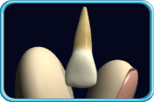
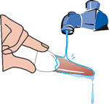
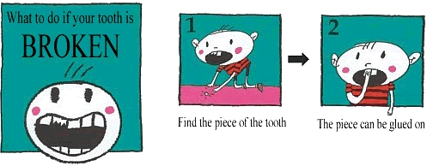
MANAGEMENT
At the site of accident:
Prevention of drying damage
Early replantation ; 15 - 20min
Instructions:
Hold by crown
Wash –plane water
Gently place in socket /milk
Report to clinic

Slide 31
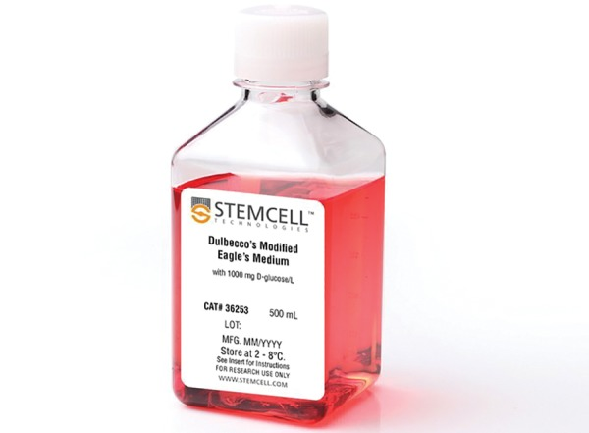
STORAGE MEDIA
Ideal requesites
Capable of preserving cellular PDL (viability)
Promotes mitogenicity
Non toxic
Preserve functional capabilities
Osmolality 290-330 Osm/mL * (critical role )
pH of 6.6 to 7.8.*

Slide 32
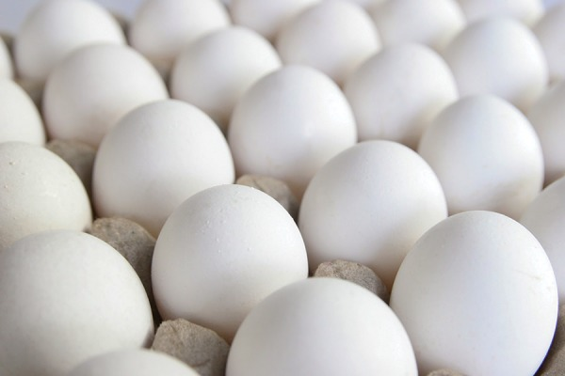
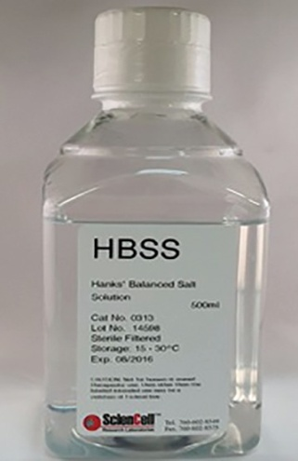
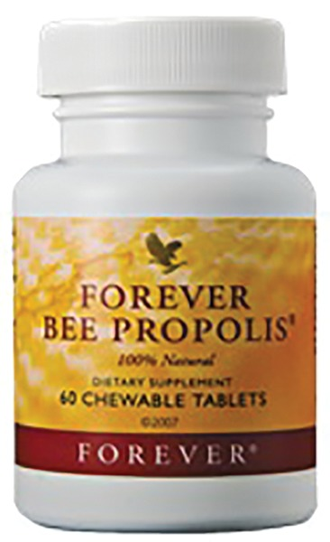
Classification:
Natural
Synthetic
GOOD ACCESSIBILTY
POOR ACCESSIBILITY
GOOD ACCESSIBILTY
POOR ACCESSIBILITY
Milk
Coconut water
Egg white
Water Saliva
Red mulbery
Propolis
Green tea
extract
milk Aloevera
Normal saline
Gatorade
Contact lens solution
ORS
Ricetral
Autologous
serum
Probiotics HBSS
Culture media
Organ storage fluids
Dento safe

Slide 33
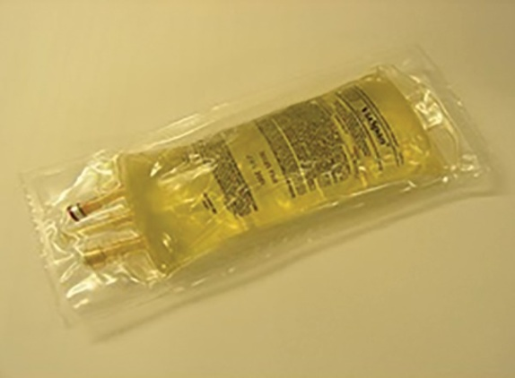
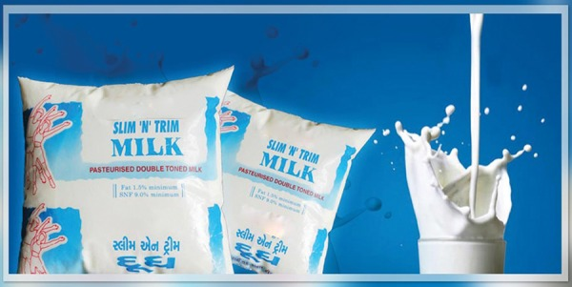
Based on cell viability:
Intermediate (upto 1 hr)
Saliva
Normal saline
Gatorade
Tap water
Short term (2 to 6 hrs )
Milk
Propolis
Green tea
Coconut water
Egg white
ORS
Red mulbery
Long term (24 to 48 hrs)
HBSS
Eagles culture medium
Dentosafe
Viaspan

Slide 34
MANAGEMENT IN THE DENTAL OFFICE :
Emergency visit :
Focus is on attachment apparatus.
Replant the tooth with maximal no of viable pdl cells.
If maintaining pdl cells in viable state is not possible, steps are taken to alter the root surface.
Endodontics is not performed extraorally at emergency visit, if any hope exists of viable pdl fibres on root surface.

Slide 35
LA recommended to carry out thorough Clinical Examination.
If tooth was replanted its position is assessed.
If repositioning is unacceptable, tooth is gently removed & replanted again.
Splinted.
Soft diet, tissue management & adjunctive therapy.

Slide 36
1] E/o dry time < 20 min with closed apex.
- Closed apex - no revitalzn,
- With suitable storage medium good Pdl healing
- Rinse the tooth with water/ saline
- Replant – gentle force & splint

Slide 37
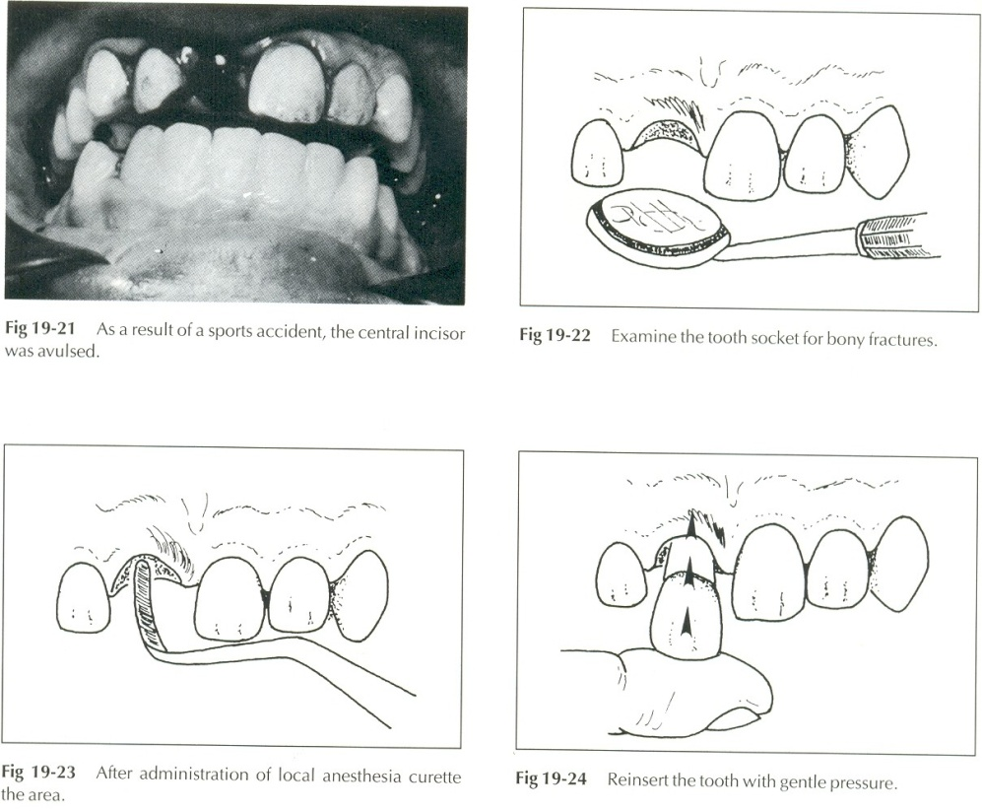
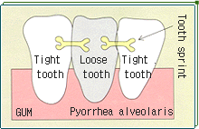
2] E/o dry time < 20 min with open apex
Open apex- revasculrzn & continued root dev,- possible
Soaking the tooth in doxycycline for 5 min - increases revasculsarization & prev bacterial growth
Rinse –saline
Replant & splint

Slide 38
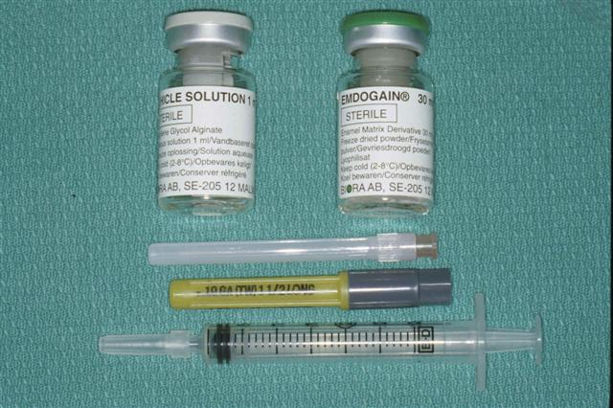
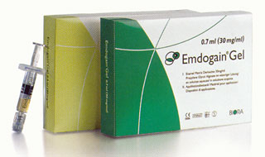
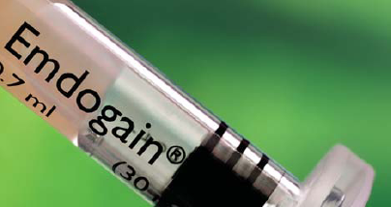
3] E/o dry time 20-60 min with open/ closed apex;
Rinse & replant at the earliest
30 min soaking in saline - removes dead pdl cells & revitalizes cells.
Viaspan ; a liver transplant medium – reduces complications post- op.
Emdogain- Emdogain – an enamel derived protein which contains proteins of the amelogenin family that has been extracted from developing porcine embryonal enamel ] in a propylene glycol alginate vehicle.

Slide 39
4] E/o dry time > 60 min open /closed apex tooth
All pdl cells – die
Root prepn to prevent resorption
- soaked in citric acid –5 min
- 2% st.fluoride – 5 min
Extra oral endo treatment – open apex
After replantion - closed apex

Slide 40
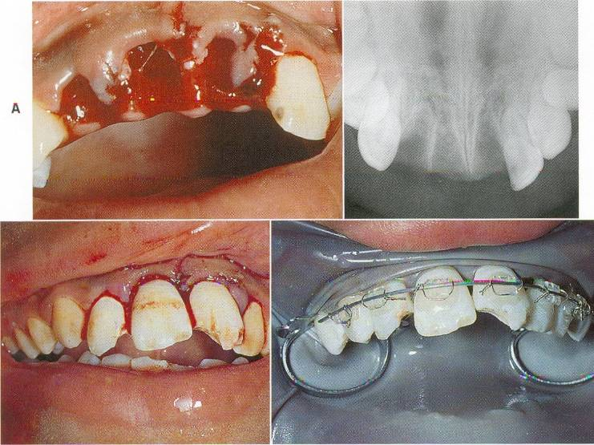
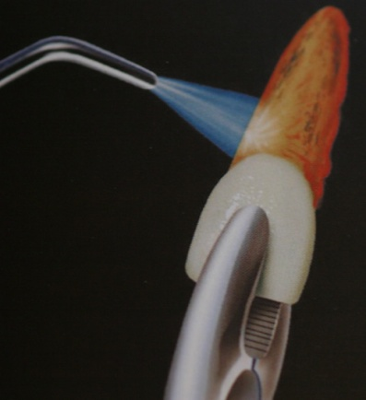
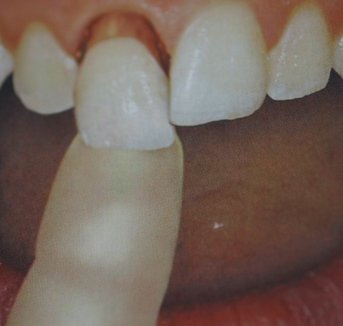
PREPARATION OF THE ROOT

Slide 41
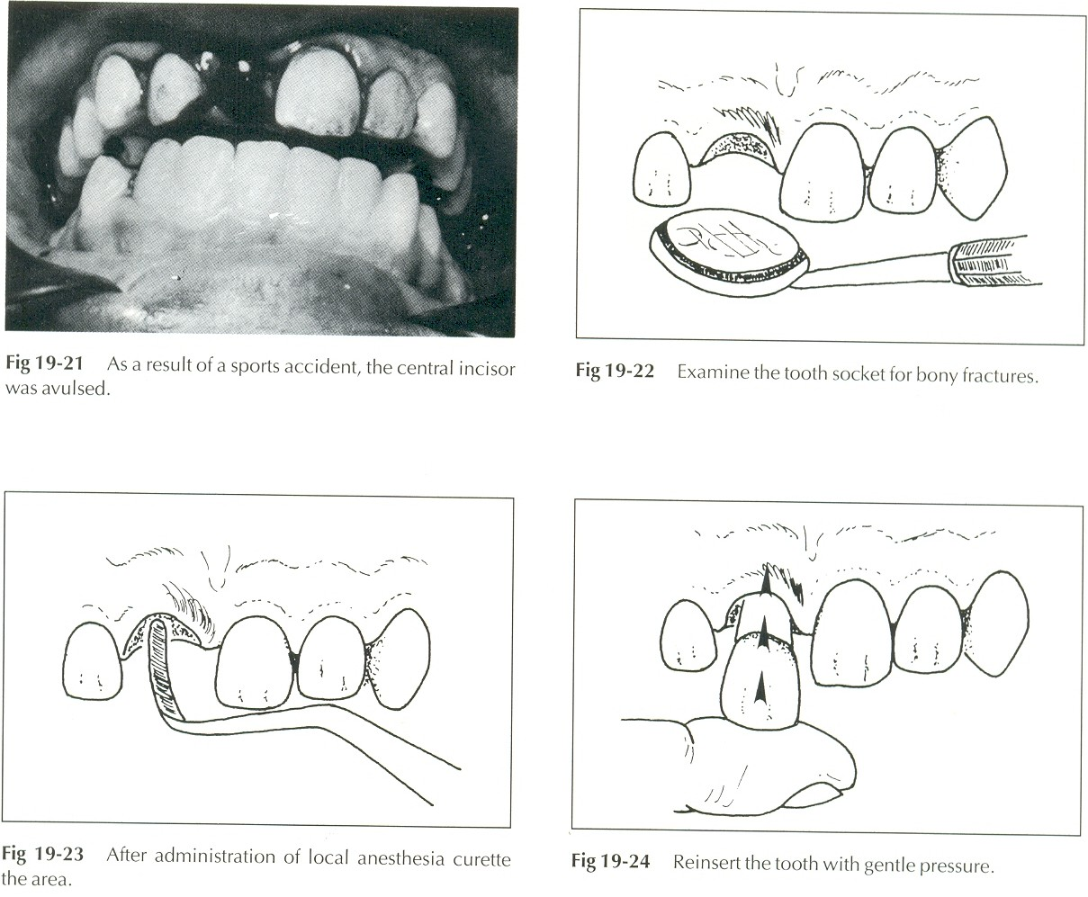
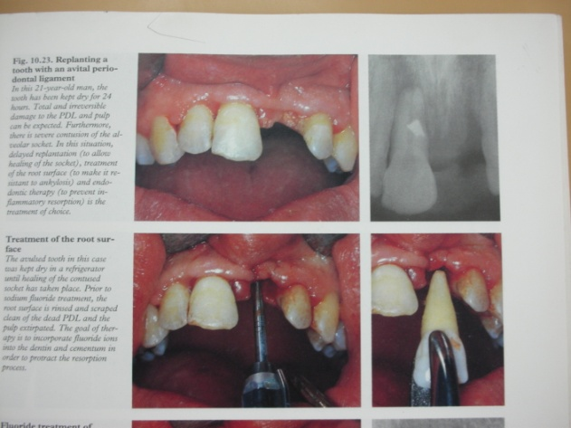
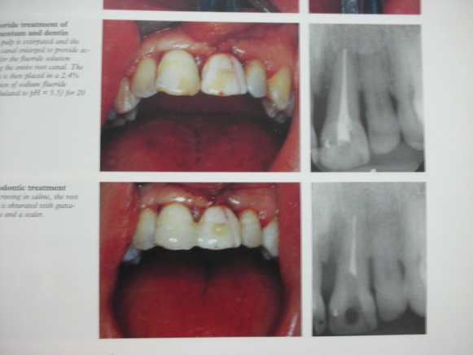
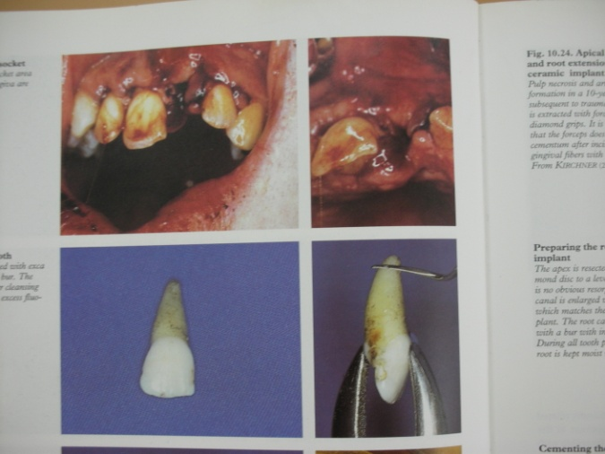
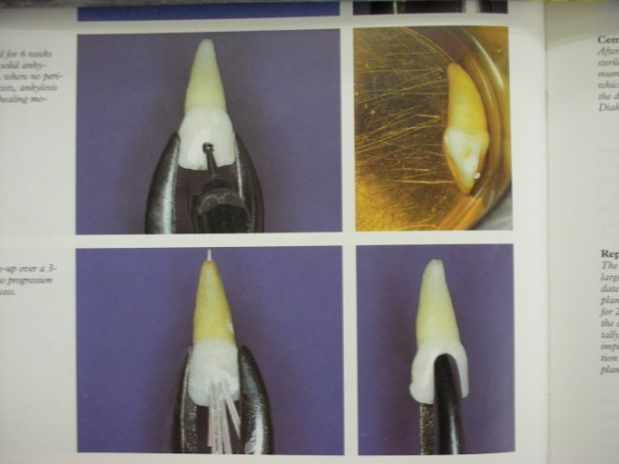
PREPARATION OF SOCKET
Rinse with saline
Aspirate clot
Reposition alvelous if any fracture
Replant & splint

Slide 42
SECOND VISIT [After 7-10 days ]
Aim: Prevention / elimination of potential irritants from root canal space
Assess initial healing
Remove splint
Start endo treatment
A] Tooth with open apex < 60 min E/o dry time;
Do sensitivity tests
Vital – root devlopment continues
Nonvital– spread infection
MANAGEMENT;
Recall every; 3-4wks
If c/f , r/f of Periapical pathosis
Apexification

Slide 43
B] Tooth with an open apex & E/O dry time > 60 min
Poor revascularization
Initiate apexification at 2nd visit
C] Tooth with a closed apex
No chance for revitalization
So endo Rx at 2 nd visit after 7-10 days
Root Canal Treatment
OBTURATION VISIT
7-14 days after 2 nd visit or when intact lamina dura is traced in long term ca[oh]2 therapy
7-10 days after replantion, start Endo Rx for closed apex tooth
- Obturation if no C/F, R/F of Periapical pathosis

Slide 44
RESTORATIONS
TEMPORARY RESTORATIONS :
Shd be atleast 4mm deep to ensure good coronal seal.
Recent materials : reinforced ZOE, acid etch comp resin & GIC.
PERMANENT RESTORATIONS :
Placed immedeiately after obturation.
Acid etch composite resin.
FOLLOW UP CARE :
Twice / yr for 3 yrs & then yearly as long as possible, as late complications are common.

Slide 45
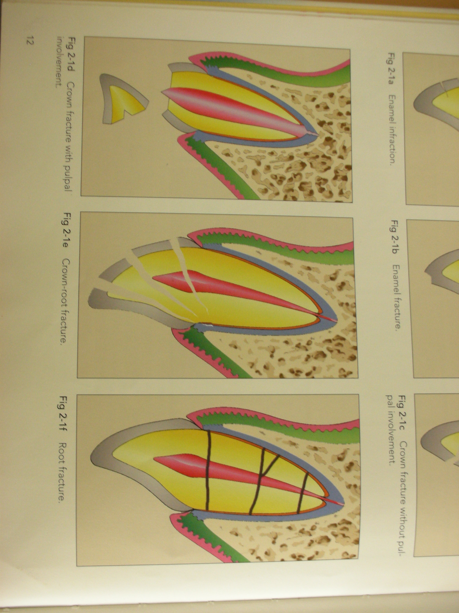
CROWN ROOT FRACTURES

Slide 46
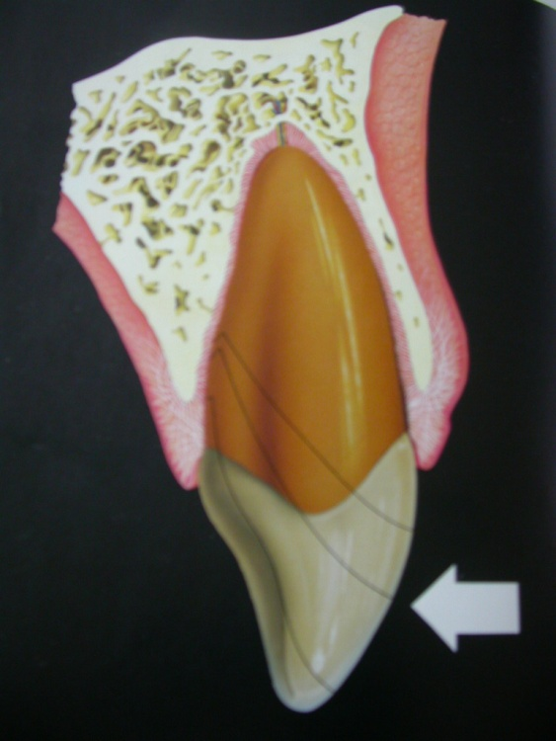
CROWN ROOT fracture:
5% of all injuries affecting permanent dentition.
Can be uncomplicated / complicated.
Clinical recognition :
Slight discomfort on moving the segment.
Radiographs contributes little to the clinical diagnosis.

Slide 47
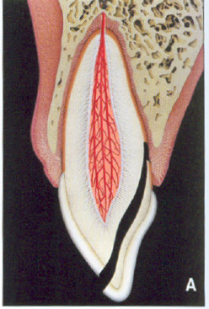
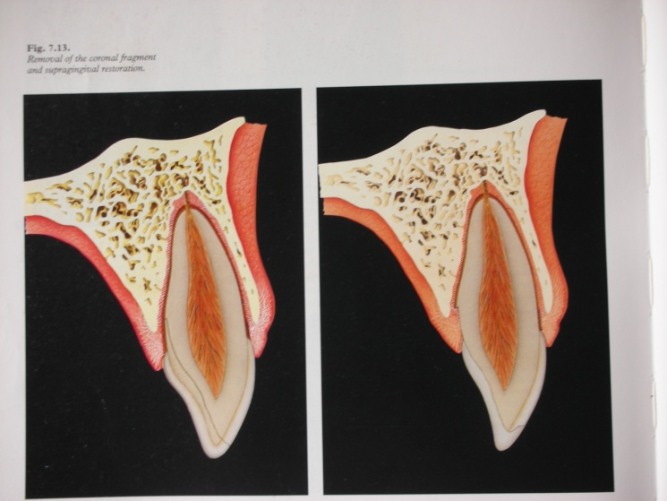
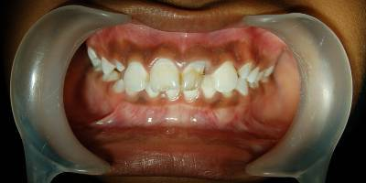
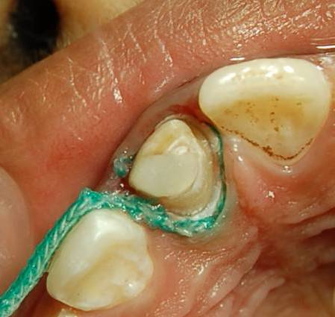
CROWN –ROOT FRACTURES
EMERGENCY TREATMENT
Stabilization of coronal fragment with an acid etch/resin splint
Multiple uncomplicated fracture in premolar and molar region - removal of loose fragments and coverage of exposed supragingival dentin with GIC
DEFINITIVE TREATMENT
Level of fracture determines the type of therapy
EXTRACTION
Coronal fragment- more than 1/3 of the clinical root
Fractures following long axis of tooth

Slide 48
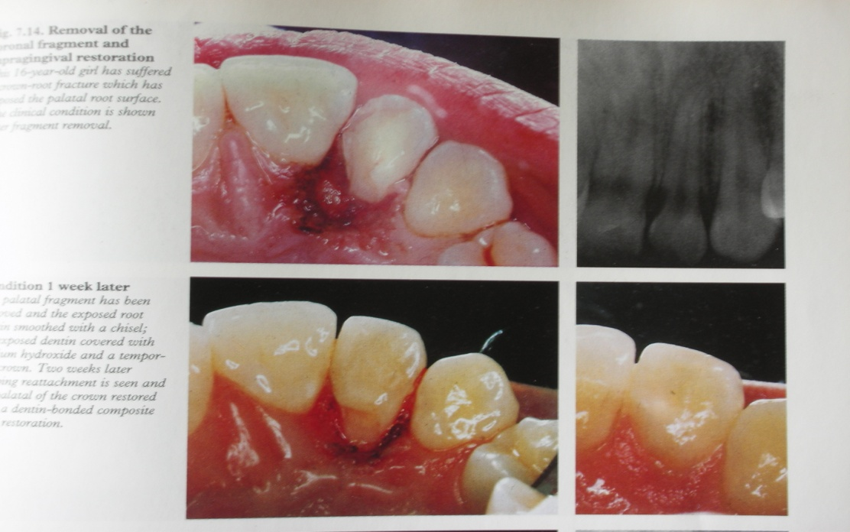

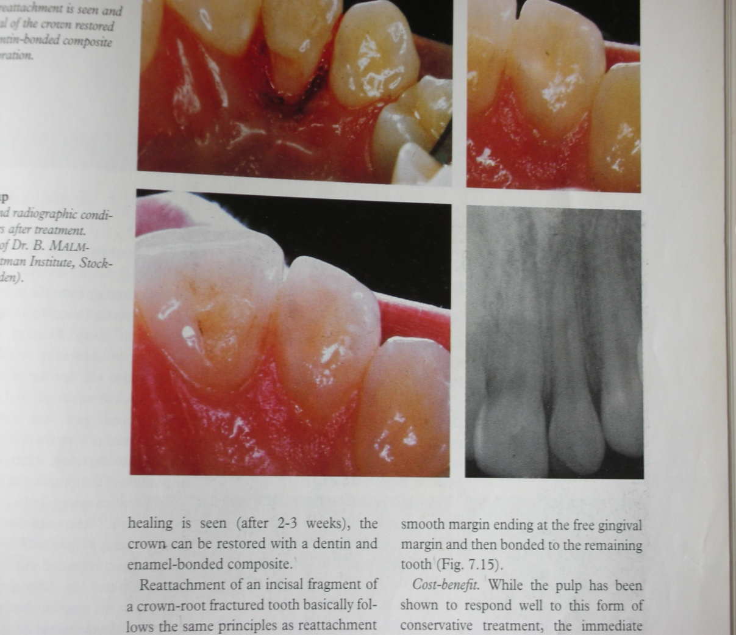
REMOVAL OF CORONAL FRAGMENT AND SUPRA GINGIVAL RESTORATION
PRINCIPLE
To allow gingival healing, then coronal portion restored

Slide 49
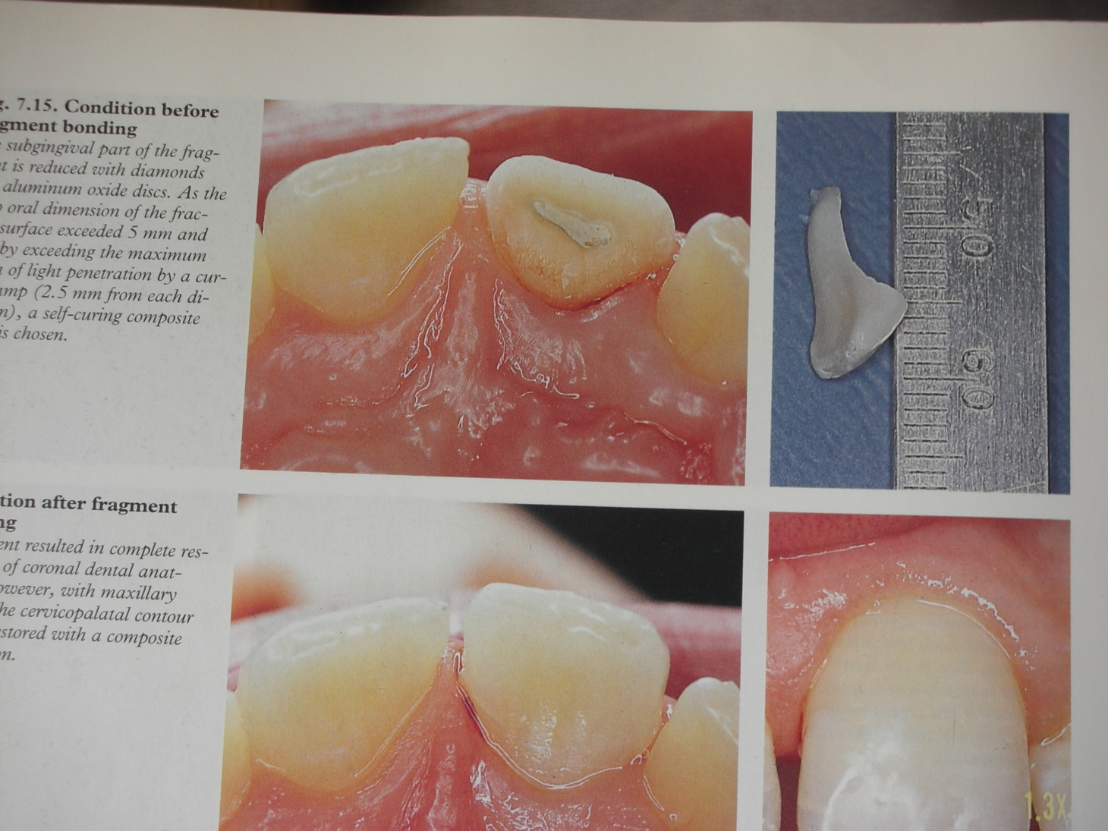
REATTACHMENT OF INCISAL FRAGMENT OF CROWN – ROOT FRACTURED TOOTH
Good pulpal response
Frequent refracture of reattached fragment/loss of composite resin build

Slide 50
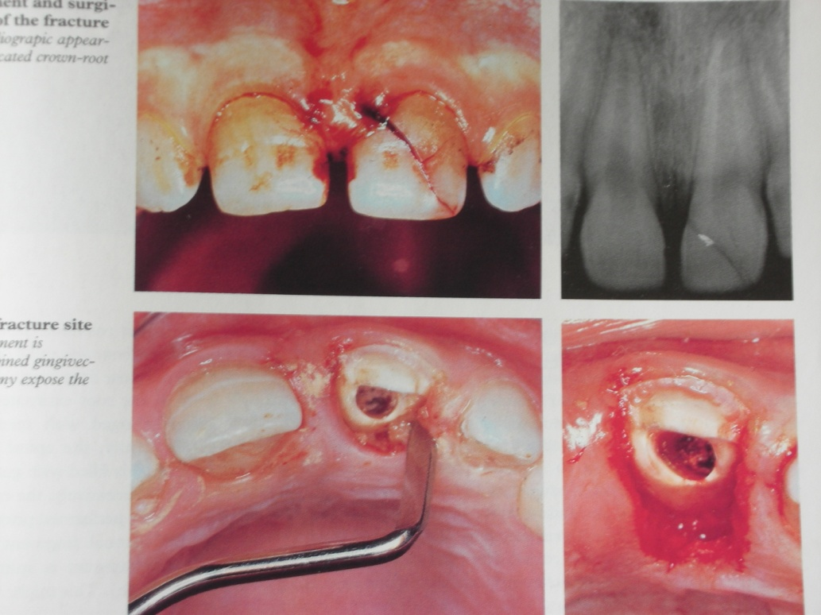
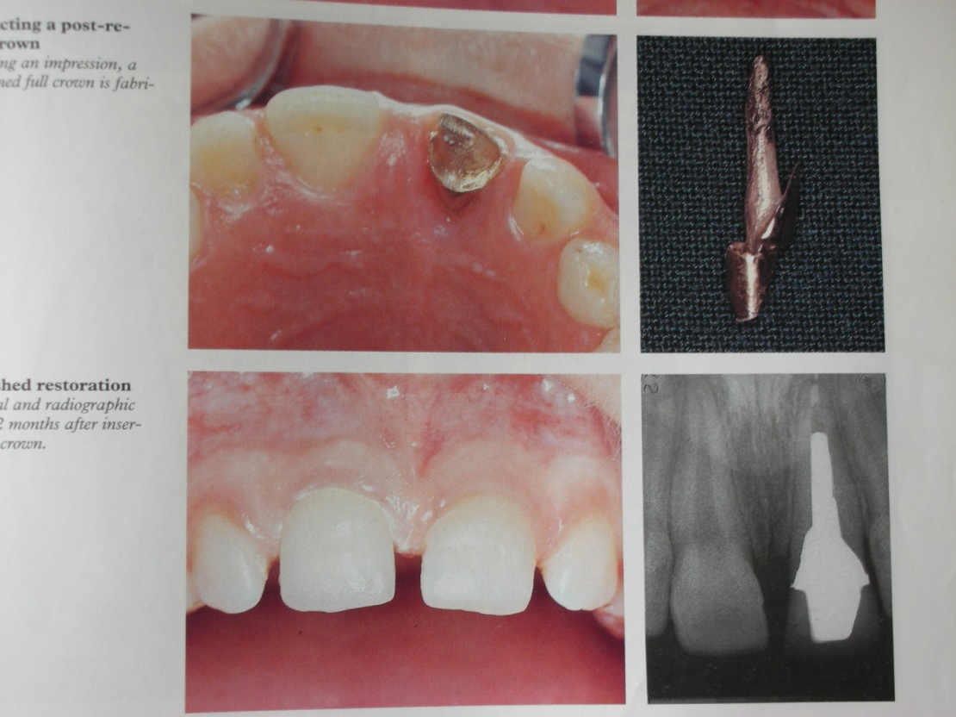
SURGICAL EXPOSURE OF FRACTURE SURFACE
PRINCIPLE
To convert subgingival fracture to a supra gingival fracture with help of gingivectomy and osteotomy

Slide 51
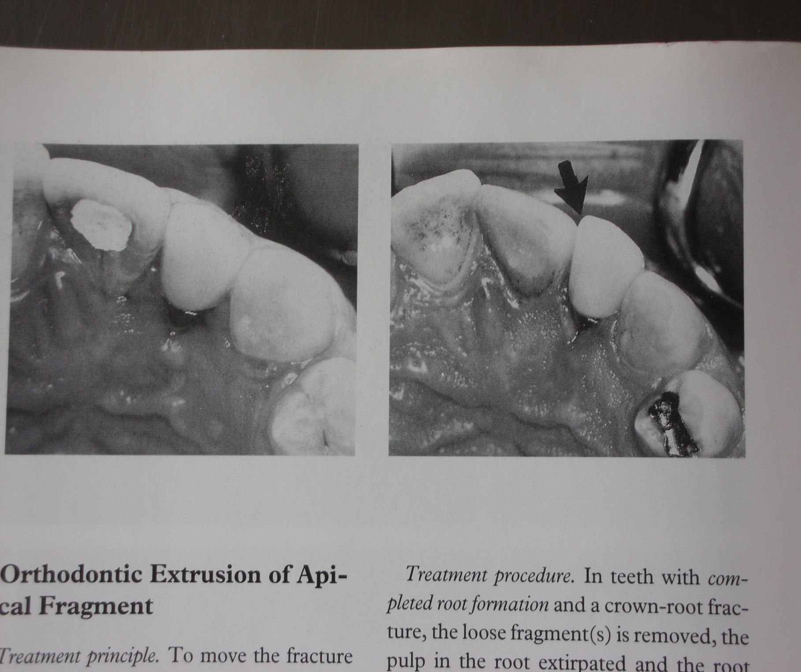
Treatment time is short,but after gingivectomy - pathologic lingual pocket n inflammation of the surrounding gingiva
After some years - facial migration of the restored teeth (approx 0.5mm /5yr)

Slide 52
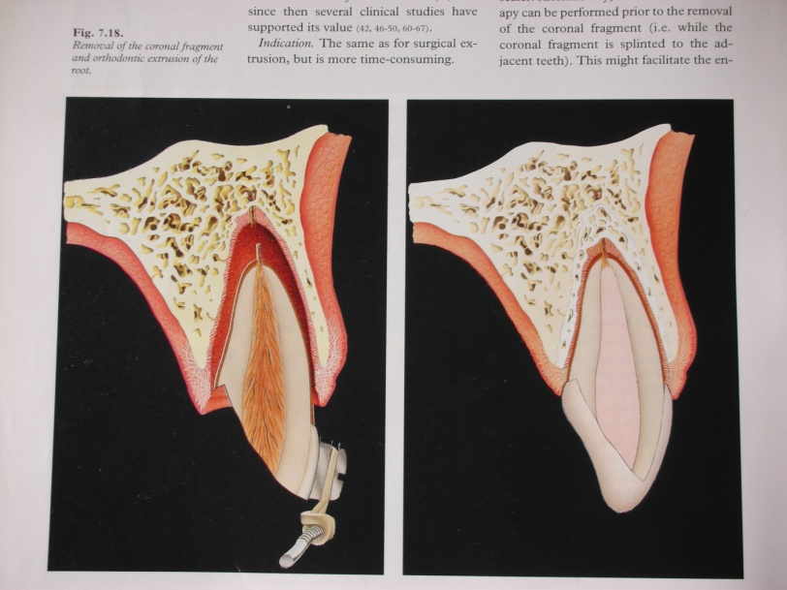
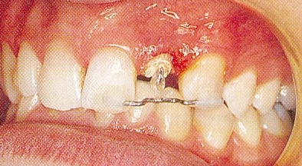
ORTHODONTIC EXTRUSION OF APICAL FRAGMENT
1973 by HEITHERSAY
PRINCIPLE
To move the fracture - supragingival position orthodontically
PROCEDURE
Teeth With Complete Root Formation
Loose fragments are removed, pulp extirpated, canal enlarged, filled with GP
Orthodontic extrusion
Teeth With Incomplete Root Formation
Pulp Capping/Pulpotomy - Orthodontic traction

Slide 53
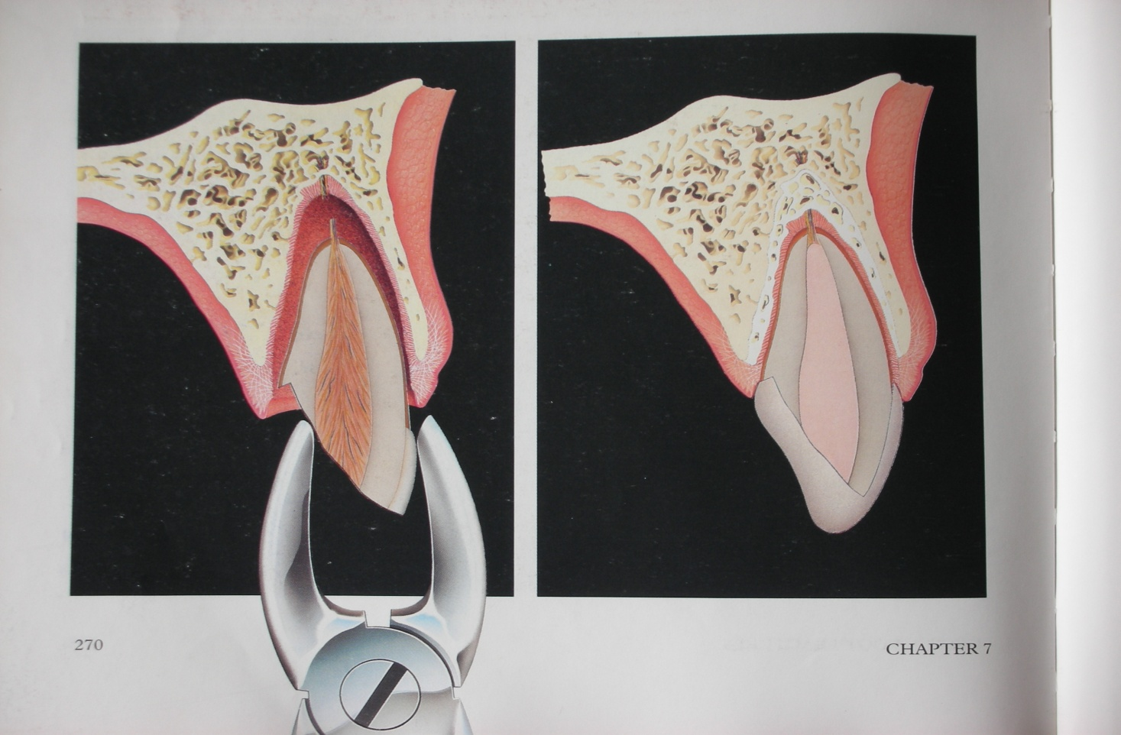
SURGICAL EXTRUSION OF APICAL FRAGMENT
PRINCIPLE
To surgically move the fracture to a supragingival position
PROCEDURE

Slide 54
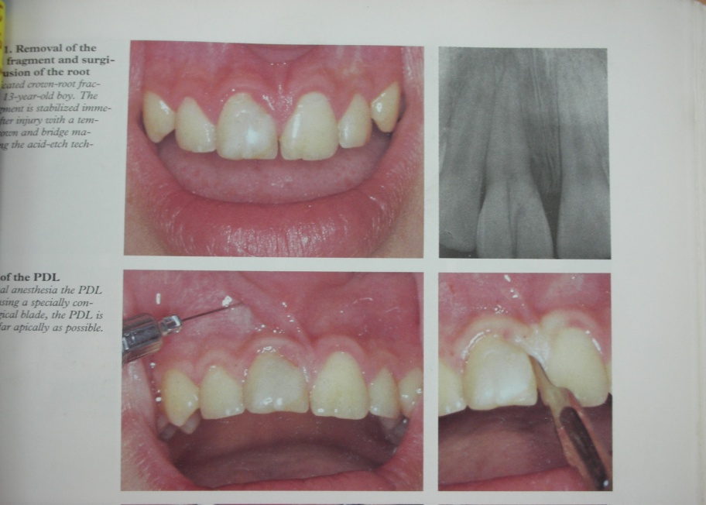
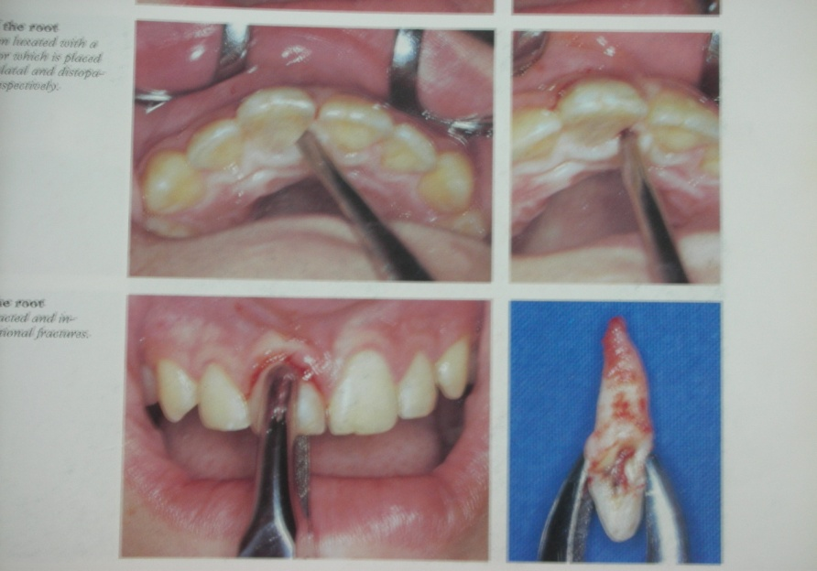
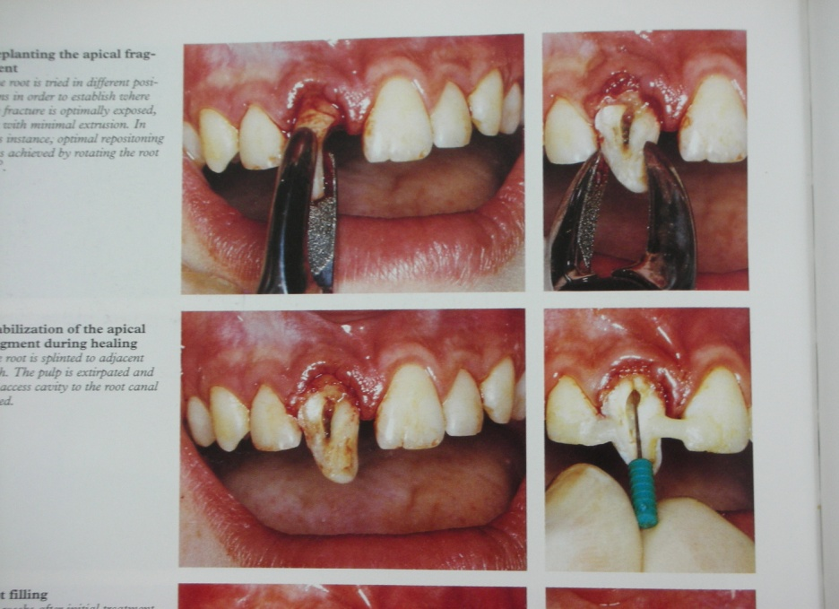
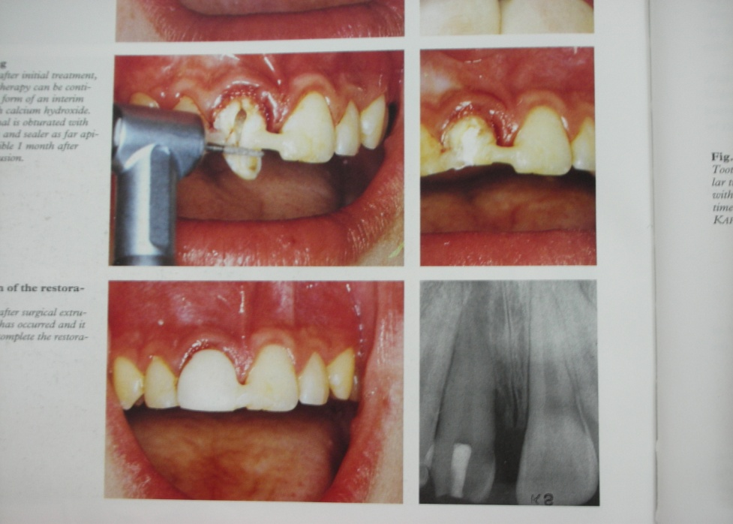
PROGNOSIS
Upto 5yr - either no / slight root resorption
Safe and rapid - but pulp vitality

Slide 55
Root Fracture

Slide 56
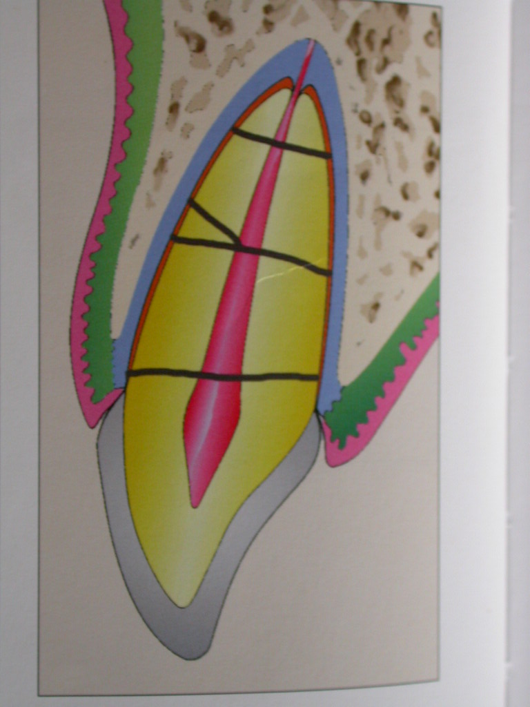
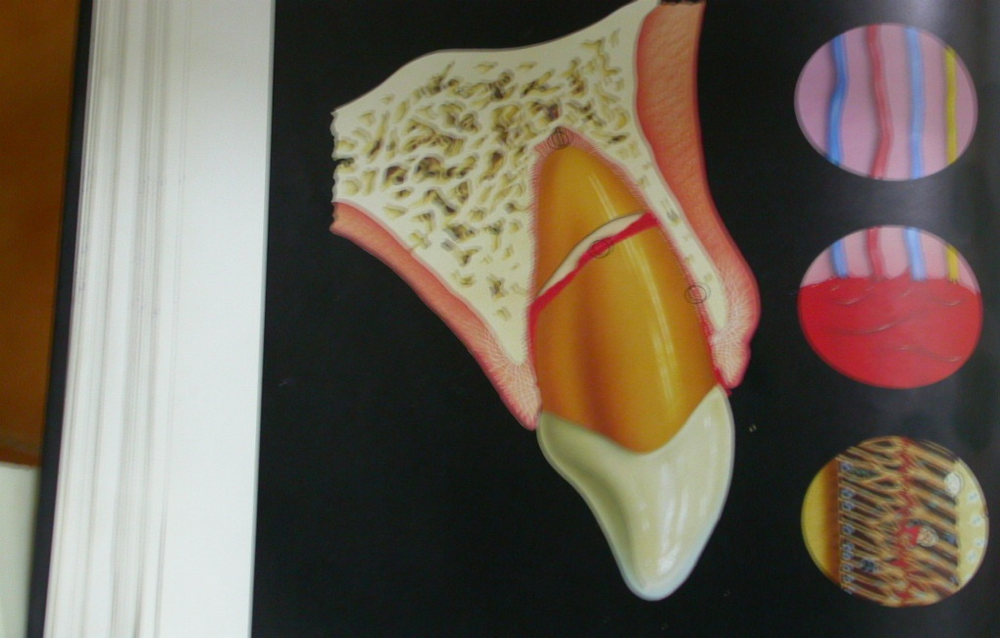
Root fracture
Fracture of cementum and dentin involving the pulp
Incidence – 0.5 -7% in permanent teeth
2-4% in primary teeth
Mechanism- Frontal impact creates a compression zones labially and lingually and the resulting shearing stress zone dictates the plane of fracture.

Slide 57
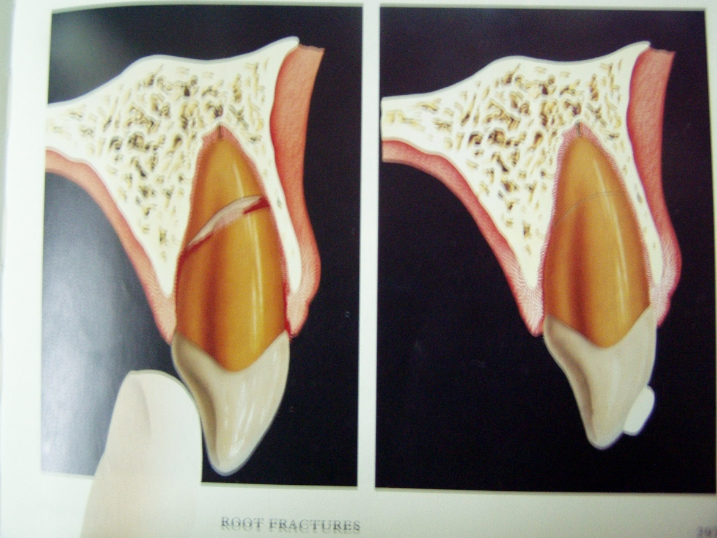
Root fracture:
One of the most unusual sequelae of traumatic teeth injury.
They may be vertical / horizontal. Vertical fracture are considered non salvageable and extraction may be the only option.
CLINICAL FEATURES :
Slightly extruded depending on the degree of dislocation.
Mobility
Sensitivity on percussion.
Bleeding emanating from the sulcus
Clinical crown may get discolored

Slide 58

RADIOGRAPHIC FEATURES :
Hori fracture easily detected radiographically.
However, most intra-alveolar fracture go occur more obliquely to the long axis of the root and unobscured radiographically.
To facilitate root detection 2 or 3 radiographs shd be exposed at varying vertical angulations.

Slide 59






Radiographic demonstration of root fracture

Slide 60
CLINICAL MANAGEMENT
1. Position of the teeth after fracture
  - Slightly lingually placed, slightly extruded
- Degree of healing depends on degree of Luxation
2. Mobility of the coronal segment
  Related to force of impact and extent of infrabony support
  Splinting period of 8-10 Weeks
  Wire plus an acid etch composite splint
  Maintenance of excellent oral hygiene

Slide 61
3. Status of the pulp
  - Patient signs and symptoms are used
  - Collateral circulation allows for vitality
  - Pulp in the apical segment is vital in all cases
  - If the apical end of the coronal segment is wide open
  Ca(OH)2 dressing given
4. Position of the fracture line
- Arbitrarily div into 3 zones

Slide 62

Zone
3
4 to 5 mm below
Alveolar margin
2
Gingival margin
1
Incisal egde

Slide 63


ZONE 1
Crown of the tooth may be lost
Gingival re - contouring and Endodontic
therapy
Post and core

Slide 64

ZONE 2
Fractures are most troublesome
Fracture exposed to saliva
Infection likely
Pulp death assured
Extract
Temp. endo. in root fragment to maintain alveolus

Slide 65

ZONE 3
Easy to manage
No separation
Easy fixation-2 months
May remain vital
May heal by cementum union

Slide 66


Healing patterns
Andreasen and Hjorting-Hansen have described four types of healing of root fractures
Healing with calcified tissue : Radiographically fracture line is discernible but the fragments are in close contact

Slide 67


2. Healing with interposition of connective tissue :
Radiographically:
fragments appear separated by narrow radiolucent line and the
fractured edges appear rounded

Slide 68

3.Healing with interposition of bone and connective tissue :
Radiographically a distinct bony ridge separates the fragments

Slide 69


TREATMENT
PRINCIPLE
Reduction of displaced coronal fragment and firm immobilization
Fracture - close to gingiva, extraction coronal fragment- orthodontic/surgical extrusion of apical fragment
Conservative approach - permanent proximal fixation
Reposition the coronal fragment, if displaced
Immobilize the tooth with a rigid splint(acid etch/resin)
Control the tooth radiographically n sensibility tests
Splint for 2-3 months
Follow up, min 1 yr

Slide 70
VERTICAL ROOT FRACTURE
Post teeth > ant teeth
Mmt: - Place a band/crown
- Relieve occlusion
Prognosis: - poor
- Extraction

Slide 71

PROGNOSIS
PULPAL HEALING
Pulp most likely to survive, luxation with no #
Pulp necrosis 20-44%

Slide 72




ROOT RESORPTION
In 60%, within 1 yr after injury
Considered to be a link in # healing n no treatment
Types :
- Ext Surface resorption
- Ext inflamm
- Ext replacement
- Int surface
- Int Tunneling
PATIENT INSTRUCTION:
- Soft diet
- Brush teeth with soft tooth brush after each meal
- Use chlorhexidine mouth rinse (0.2%) twice a day for 7 days

Slide 73

Luxation Injuries

Slide 74



CONCUSSION/SUBLUXATION
Occlusal grinding of opposing teeth
Immobilization may be indicated, especially in case of marked loosening
Soft diet for 14 days
supplemented by radiographs and repeated pulp tests during the follow up period –min 1 yr

Slide 75




EXTRUSIVE LUXATION
Careful repositioning , no L. A required
Flexible Splint for 2-3 weeks

Slide 76


LATERAL LUXATION
Repositioning is forceful, L.A
Dislodge the root tip from its bony lock, firm digital pressure in incisal direction then maneuvered apically into its correct position
Forceps can be applied - slightly extruded past the bony alveolar lock and the directed back into its correct position
Labial and palatal bone plates should be compressed
Lacerated gingiva is sutured, splinting done and radiograph
If repositioning delayed more than 48 hrs - difficult

Slide 77





Slide 78


INTRUSIVE LUXATION
Intruded immature and mature teeth re-erupt spontaneously, in 2-3 months
Important to reposition within 2-3 weeks - endodontic therapy
Treatment of choice in both immature and mature teeth is ortho repositioning over a period of 3-4 weeks

Slide 79





Slide 80
SPLINTING
DEFINITON :Dental splint is a rigid or a flexible device or compound used to support, protect or immobilize teeth that have been loosened, replanted, fractured or subjected to certain endodontic surgical procedure. (AAE)
INDICATIONS
An avulsed tooth
Displaced tooth
An extruded tooth
A root fractured tooth that is mobile
A mobile tooth interfere eating
IDEAL PROPERTIES OF SPLINT
Physiological Healing (To optimize Healing)
- Stabilize the traumatized teeth - anatomical position
- Allow some physiological mobility - promote healing
- Provide adequate fixation
- Cause no damage to the teeth, gingiva and soft tissues -
NOTE :After Root fracture Splint should be rigid to permit optimal formation of a dental callus to unite the root fragments

Slide 81

TYPES OF SPLINT
Tissue coverage splints
Composite resin & wire[ 0.7mm] splint
Acrylic resin & wire splint
Fiber-filled acrylic splint
Bonded brackets & arch wire splint
Titanium Trauma splint
Inter dental wiring & Arch bar splint
Laboratory splints
a] Acrylic
b] Thermoplastic
Preferred n fulfills most of the demands

Slide 82




Slide 83
DURATION OF SPLINTING [ Andreasen & Andreasen (1990)]
Avulsion - 7-10 days
Subluxation - 2 wks
Extrusion - 2-3 wks
Intrusion - 6-8 wks
Lat, luxation - 6-8wks
Root fracture - 2- 4mnths
Dento-Alveolar fracture - 4 -8 wks
ADJUNCTIVE THERAPY
Tetanus booster < 48hrs.
Systemic antibiotics –5-7 days
analgesics
Oral hygiene – chx rinse
Advised :Liquid / soft diet

